Slide 1
Geometric Patterns
Algebra Day 1

Slide 2

Warm Up
Keeley, Greg, and Katie were trying to figure out a pattern. The first figure had a square with a dot on the top side. The next figure had a square with a dot on the right side. The third had a square with a dot on the bottom side. Looking at this pattern, what would the next figure look like?

Slide 3
Geometric Patterns
Patterns that use shapes
  EX :
  Base Pattern
  A base pattern is the part of the pattern that repeats itself.
  What are the next three shapes in this pattern?

Slide 4

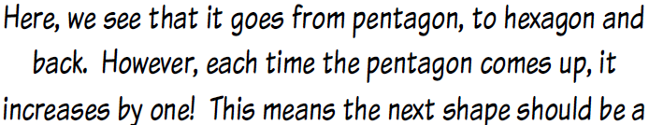
Geometric Patterns Cont.
Sometimes a pattern will increase or “grow” as it goes.
  EX:

Slide 5
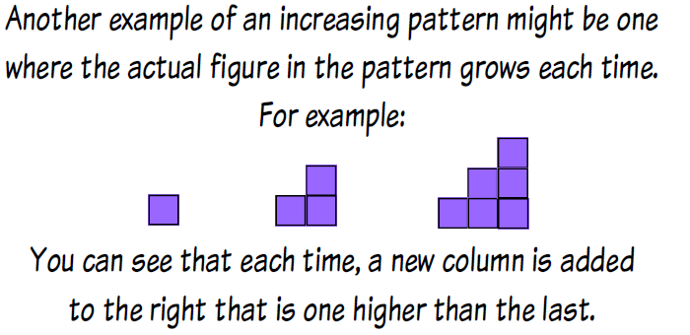

Geometric Patterns Cont.

Slide 6
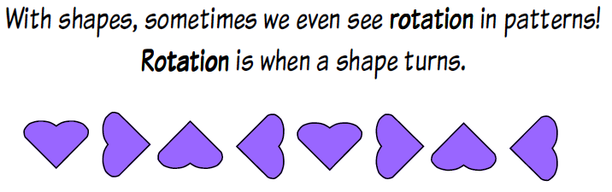
Geometric Patterns Cont.

Slide 7
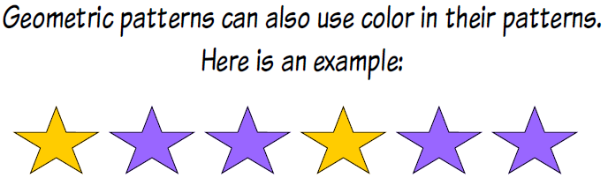
Geometric Patterns Cont.

Slide 8
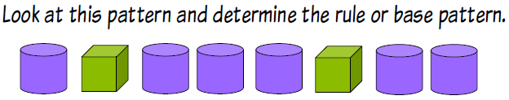
Let’s Practice!

Slide 9
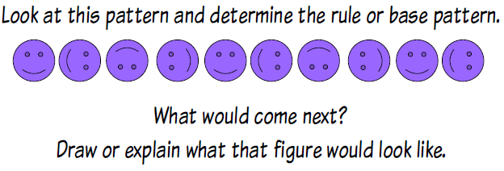
Let’s Practice

Slide 10
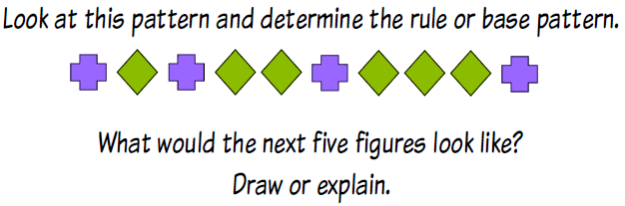
Let’s Practice

Slide 11
It’s Your Turn!
Complete Problem Set
Work on Center

Slide 12
Numerical Patterns
Algebra Day 2

Slide 13
Warm-Up
Denise and Levar were playing a game. They each had a pattern and needed to see who would hit the number 8 first. If they both start with 1 and Denise’s rule is “add three, subtract one” and Levar’s rule is “add five, subtract three,” who will get to eight first? How many numbers will it take each of them to get to eight?

Slide 14
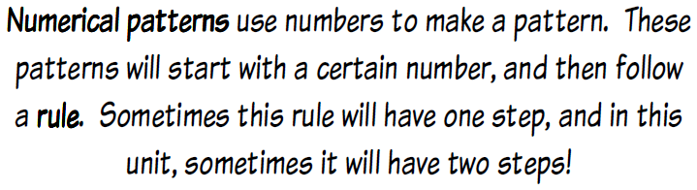

Numerical Patterns

Slide 15
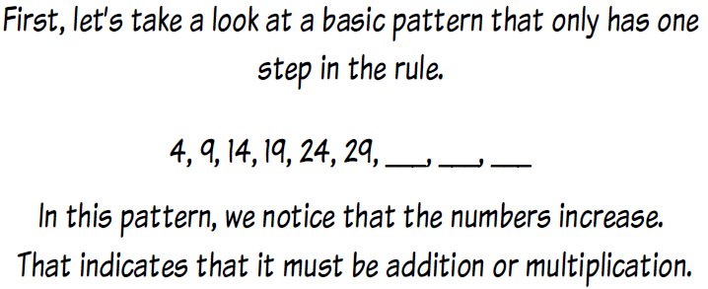

Numerical Patterns Cont.

Slide 16
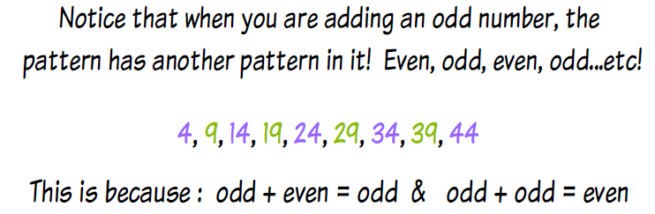

Numerical Patterns Cont.

Slide 17
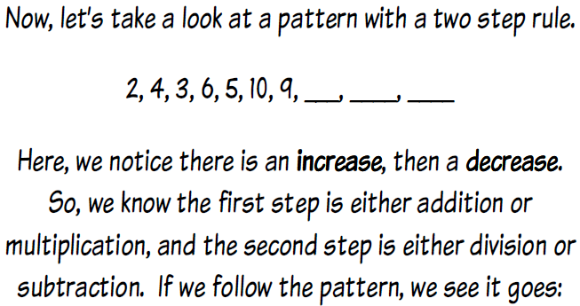

Numerical Patterns Cont.

Slide 18
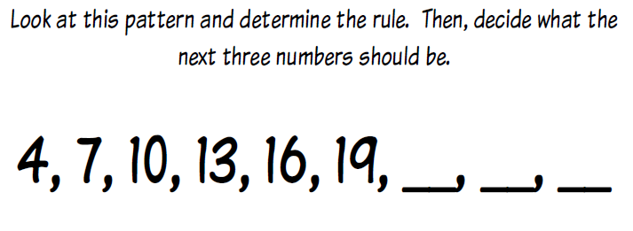
Let’s Practice!

Slide 19
Let’s Practice!
5, 8, 11, 14, 17, __, __, __

Slide 20
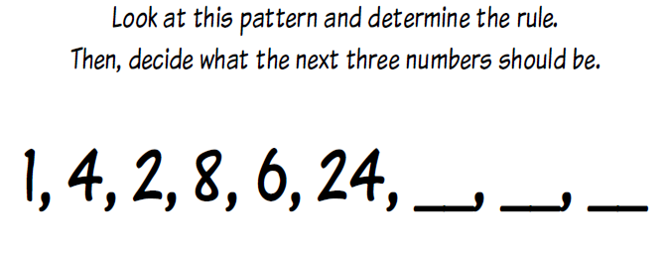
Let’s Practice!

Slide 21
Let’s Practice!
1, 3, 6, 10, 15, 21, ___, ___, ___

Slide 22
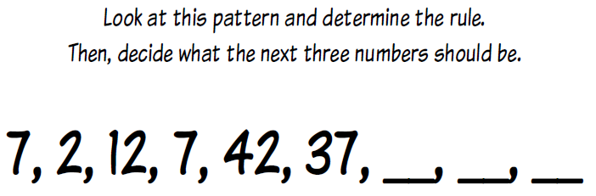
Let’s Practice!

Slide 23
Let’s Practice!
24, 12, 120, 60, 600, 300, ___, ___, ___

Slide 24
It’s Your Turn!
Complete Problem Set
Work on Center

Slide 25
One Step Equations
Algebra Day 3

Slide 26
Warm-Up
Melvin planted 1,564 stalks of corn. He has harvested some of the corn and noticed that he has 785 stalks left that have not been harvested yet. How many stalks has he harvested? Write an equation to help him figure it out. Solve for your variable.

Slide 27
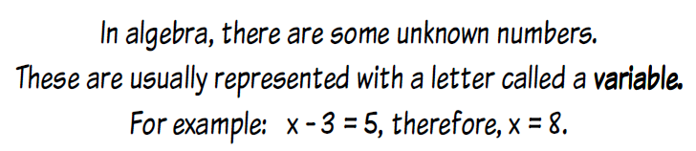
Variables?

Slide 28
How Do We Solve An Equation?
Let’s begin with addition. You might see an equation like 4+ t = 8.
To help you solve you can think of fact families
  Remember that addition and subtraction go together and there are two of each kind of problem.
4 + t = 8
t + 4 = 8
8 – t = 4
8 – 4 = t – this is the only fact family equation that is solvable.

Slide 29
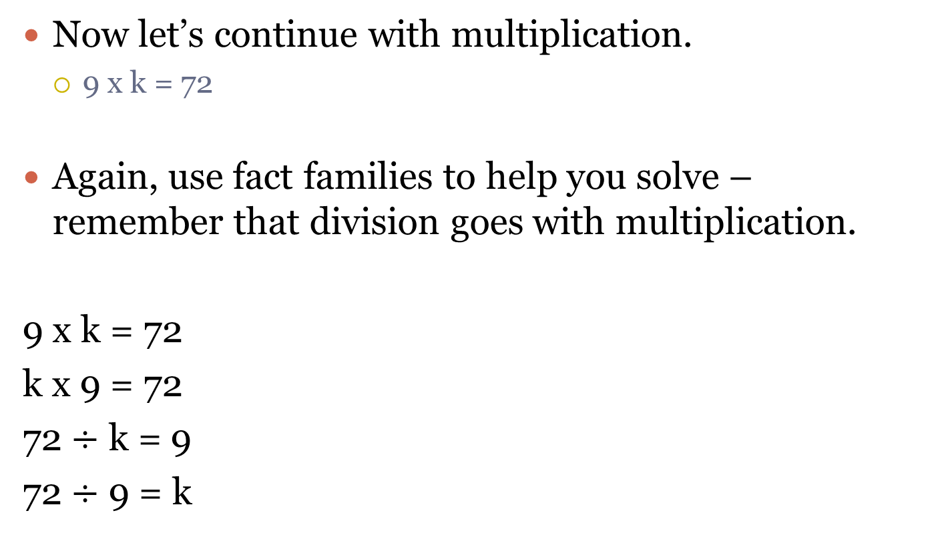
Equations with Multiplication
Now let’s continue with multiplication.
  9 x k = 72
Again, use fact families to help you solve – remember that division goes with multiplication.
9 x k = 72
k x 9 = 72
72 $÷$ k = 9
72 $÷$ 9 = k

Slide 30
Equations with Subtraction
Let’s continue with subtraction. Remember the inverse of subtraction is addition.
r – 9 = 21 – remember, in subtraction, the biggest number always goes first, so in this equation, r would be the greatest number.
Again, think of fact families
r – 9 = 21
r – 21 = 9
21 + 9 = r
9 + 21 = r

Slide 31
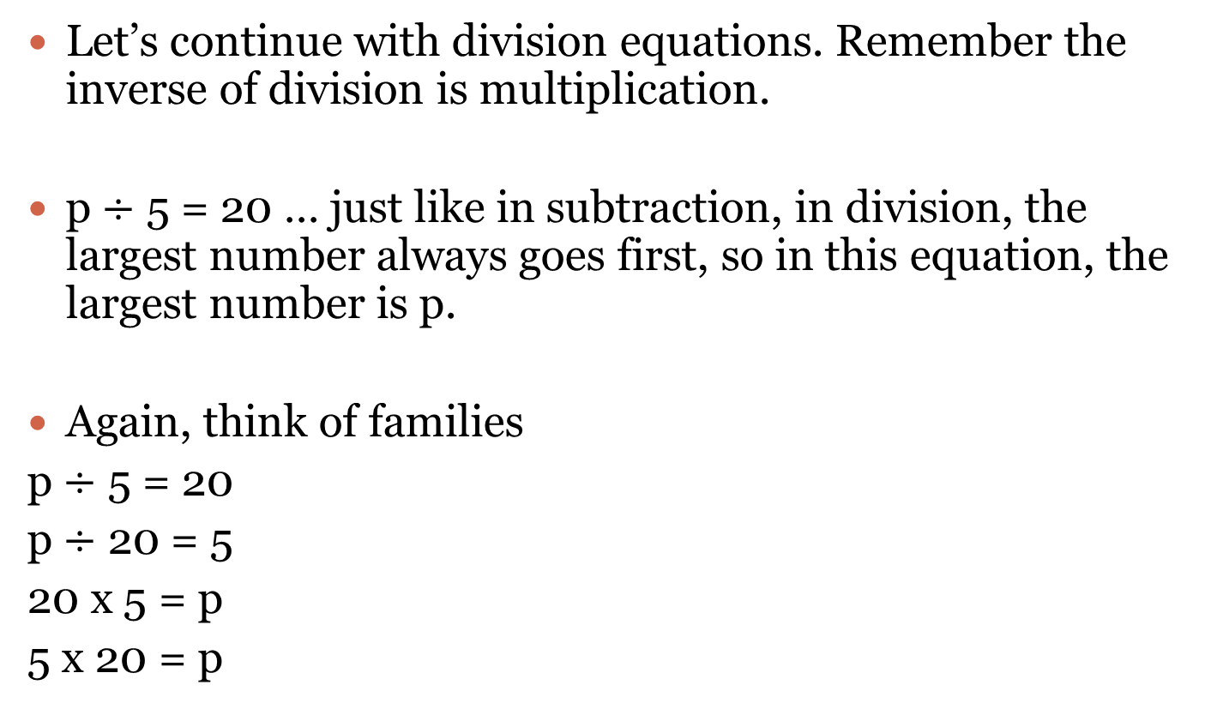
Equations with Division
Let’s continue with division equations. Remember the inverse of division is multiplication.
p $÷$ 5 = 20 … just like in subtraction, in division, the largest number always goes first, so in this equation, the largest number is p.
Again, think of families
p $÷$ 5 = 20
p $÷$ 20 = 5
20 x 5 = p
5 x 20 = p

Slide 32
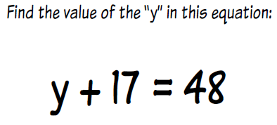
Let’s Practice!

Slide 33
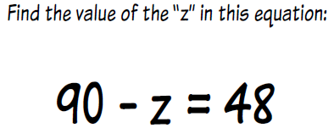
Let’s Practice!

Slide 34
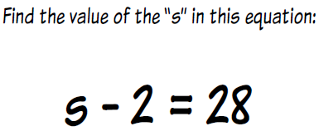
Let’s Practice!

Slide 35
Let’s Practice!
Find the value of “k” in this equation.
5 x K = 85

Slide 36
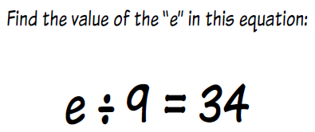
Let’s Practice!

Slide 37
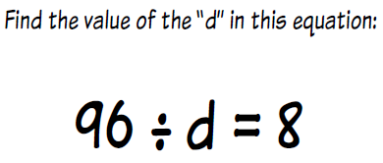
Let’s Practice!

Slide 38
It’s Your Turn!
Complete Problem Set
Work on Center

Slide 39
Function Tables
Algebra Day 4

Slide 40
Warm-Up
If Katherine had a function table with 3 x d = t, and she needed t to be 15, what would d need to equal?

Slide 41
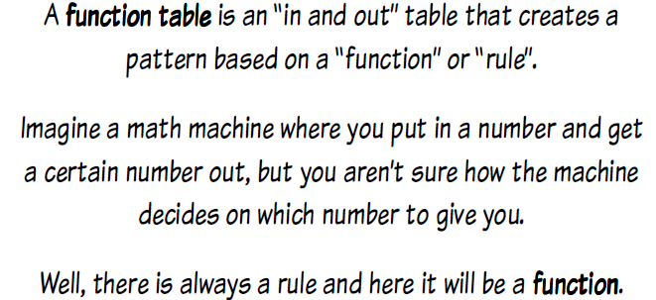
What is a Function Table?

Slide 42

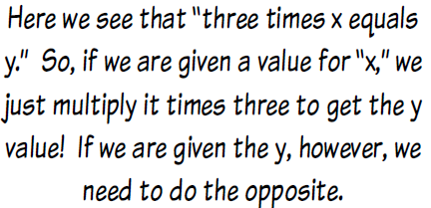
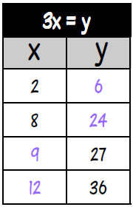

Function Tables

Slide 43


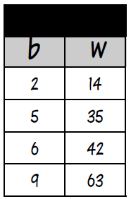


Function Tables

Slide 44

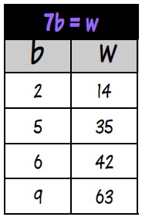
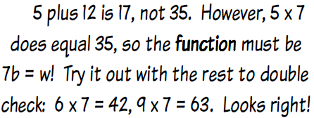
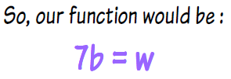
Function Tables

Slide 45
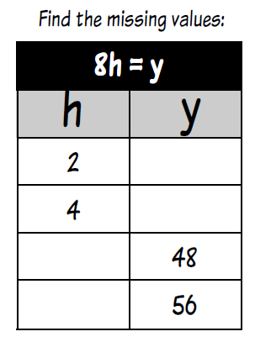
Let’s Practice!

Slide 46
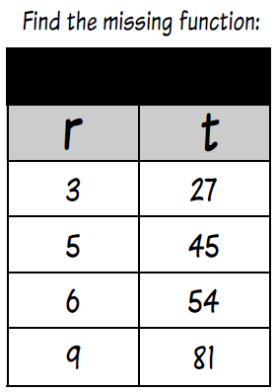
Let’s Practice!

Slide 47
It’s Your Turn!
Complete Problem Set
Work on Center

Slide 48
Day 5
Book Activity

Slide 49
Days 6-7
Use printouts from Howard County PS with homework I have created.

Slide 50
Algebra Reteach/Game Day

Slide 51
Test Review

Slide 52
Test

Slide 53
Fractions Lesson 1

Slide 54

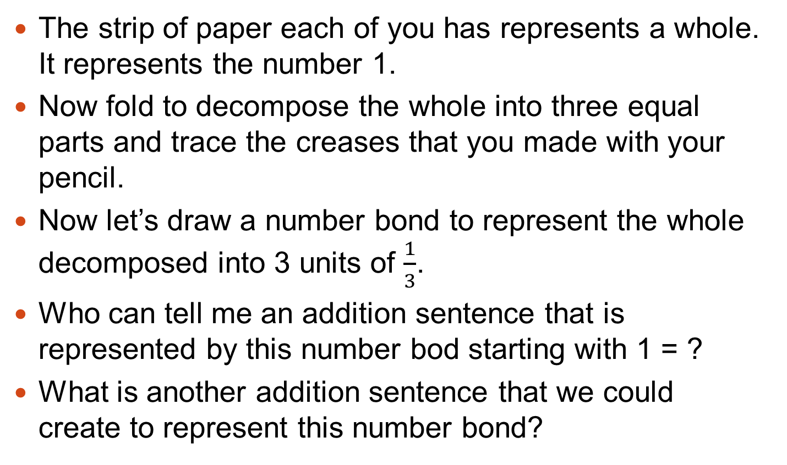
The strip of paper each of you has represents a whole. It represents the number 1.
Now fold to decompose the whole into three equal parts and trace the creases that you made with your pencil.
Now let’s draw a number bond to represent the whole decomposed into 3 units of $\frac{1}{3}$.
Who can tell me an addition sentence that is represented by this number bod starting with 1 = ?
What is another addition sentence that we could create to represent this number bond?

Slide 55
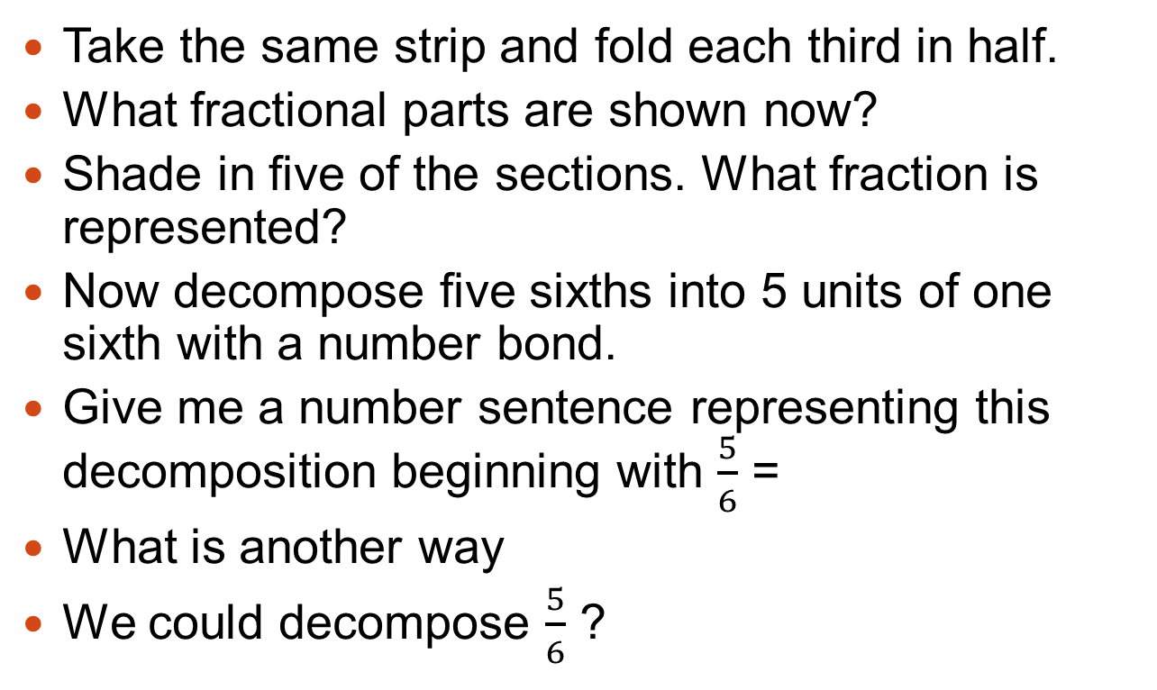
Problem 1 continued
Take the same strip and fold each third in half.
What fractional parts are shown now?
Shade in five of the sections. What fraction is represented?
Now decompose five sixths into 5 units of one sixth with a number bond.
Give me a number sentence representing this decomposition beginning with $\frac{5}{6}$ =
What is another way
We could decompose $\frac{5}{6}$ ?

Slide 56
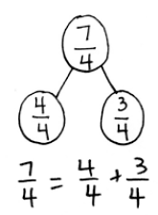
Problem 2
Now take two new strips of paper and fold them each into fourths.
Shade each of the sections on the first strip and 3 of the sections on the second strip.
What total fraction is shaded? Draw a number bond that represents the two parts and their sum.

Slide 57
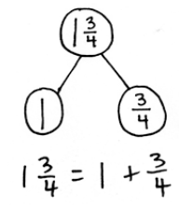
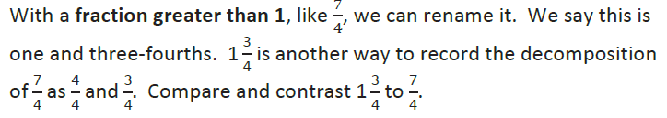
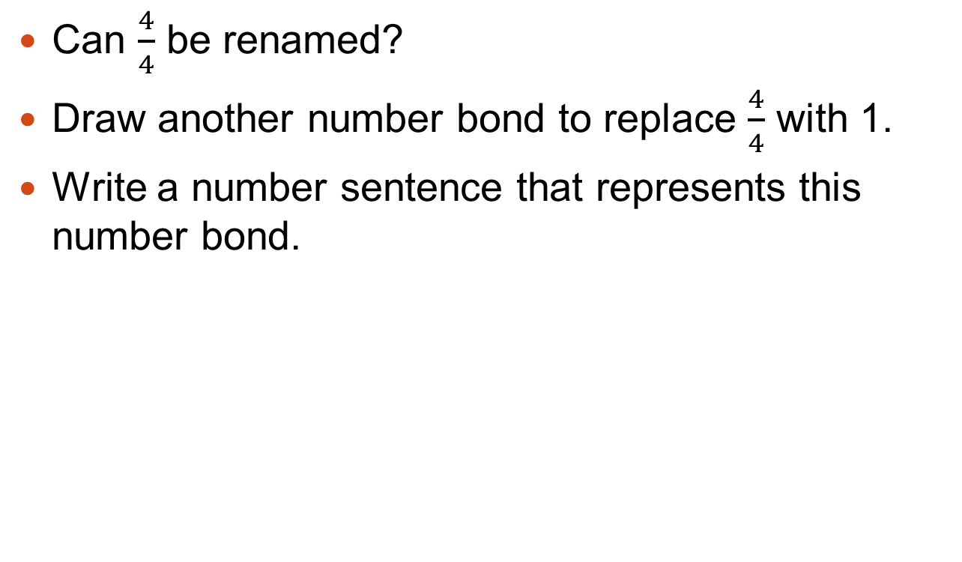
Problem 2 Cont.
Can $\frac{4}{4}$ be renamed?
Draw another number bond to replace $\frac{4}{4}$ with 1.
Write a number sentence that represents this number bond.

Slide 58
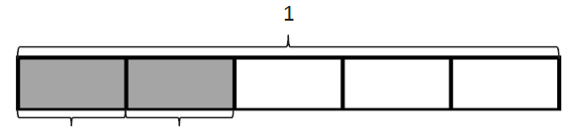

Problem 3
Name the unit fraction represented by the rectangle.
We could say:

Slide 59
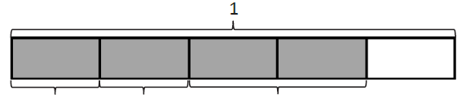
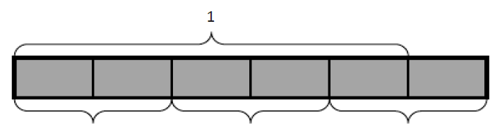
Problem 3 Cont.
Write an addition sentence to represent the following tape diagram.
Now look at the diagram below. Discuss with your partner what fraction is represented.

Slide 60


Problem 4
Work with a partner to draw a tape diagram that represents the following equation.

Slide 61
It’s your Turn!
Complete the problem set.

